Slide 1
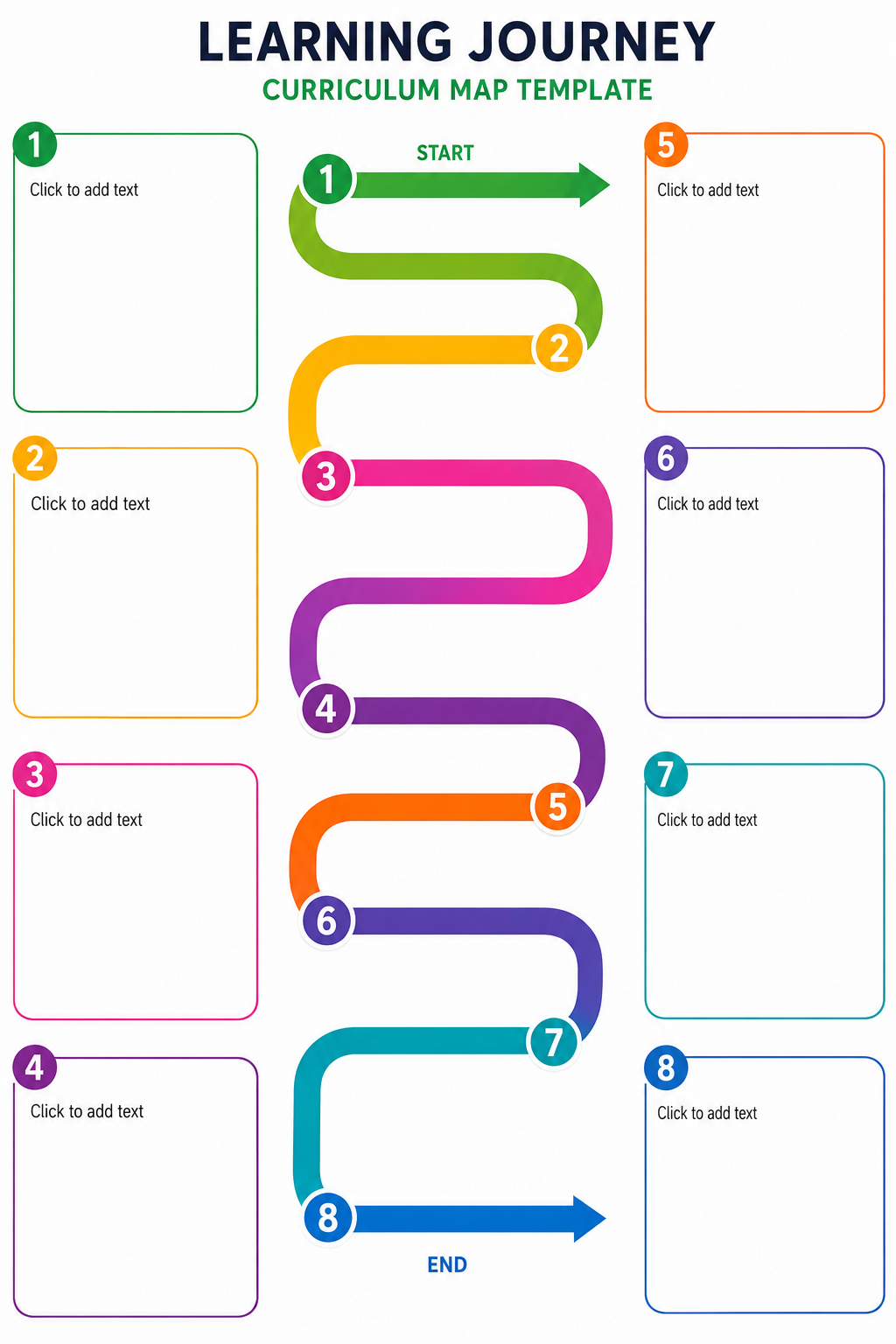
Immersion
Videos
Pictures
Music
Role play
Role on the wall
Hot seating
Debates
Conscience ally
more...
Sentence stacking
Dictation
Improve sentences
Sentence stacking using S/C
Model Text
Read the model text – various ways
Planning cycle using S/C
Unpick as a reader
What is the purpose?
Discuss vocabulary
How does it make you feel as a reader?
Independent writing
Unpick as a writer
What did the writer use?
Unpick structure and language choices
Editing process

